Slide 1

Data Management for DEMI:
Registration Request & Some Use Cases
Victor Dudarev, Alfred Ludwig

Slide 2
Agenda
    Registration and Authorisation
    Roles and Access Levels
    Customisation (new Object Types: no-code approach)
    Properties & Templates (List + Table)
    Sample Type and Lifecycle Workflow (states & splitting)
    Handover Event (Sample Tracking)
    Reports & Statistics
    Q&A

Slide 3
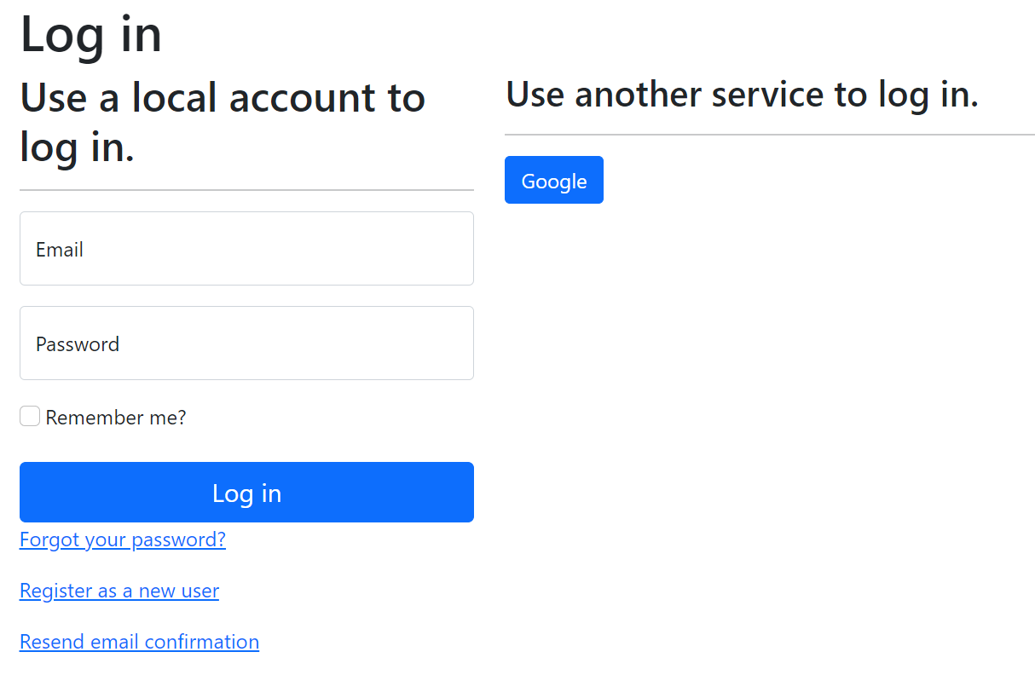
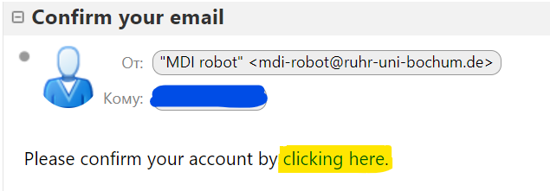
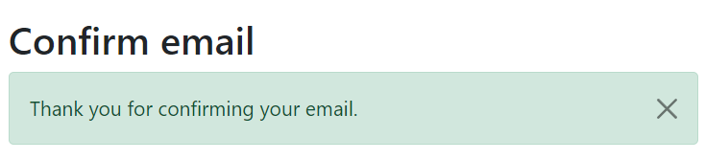
RDMS: Registration and Authorization
Application access level is determined by the current user context.
Two-way registration (choose any):
using external provider (OpenID Connect), e.g. Google (external authentication authority is used, no credentials are stored locally).
using local account (credentials are stored internally);
In both cases, an e-mail address is required, and its successful verification is a prerequisite for access.
After e-mail confirmation, the user is considered active, but does not have an assigned user group.
https://openid.net
https://en.wikipedia.org/wiki/Authentication
https://en.wikipedia.org/wiki/Authorization

Slide 4
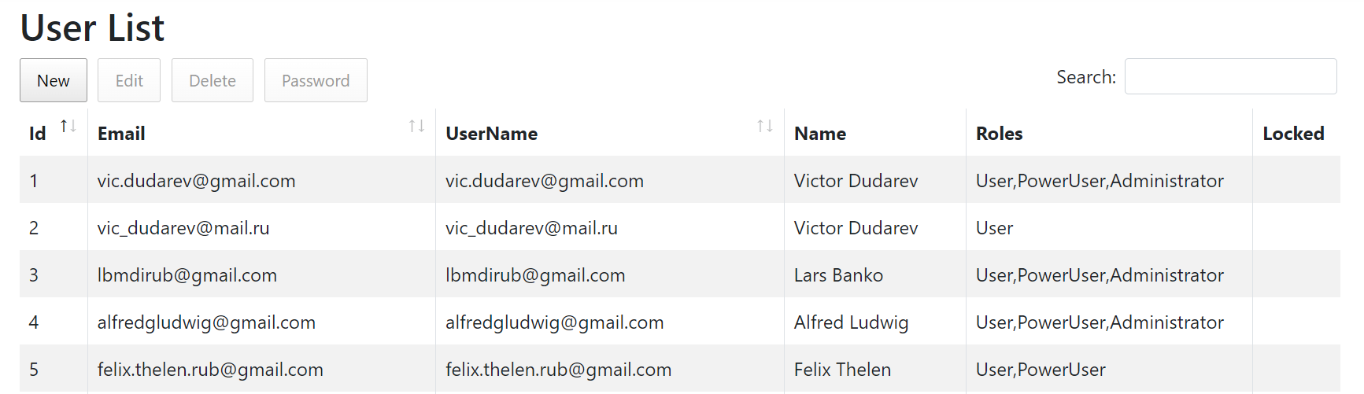
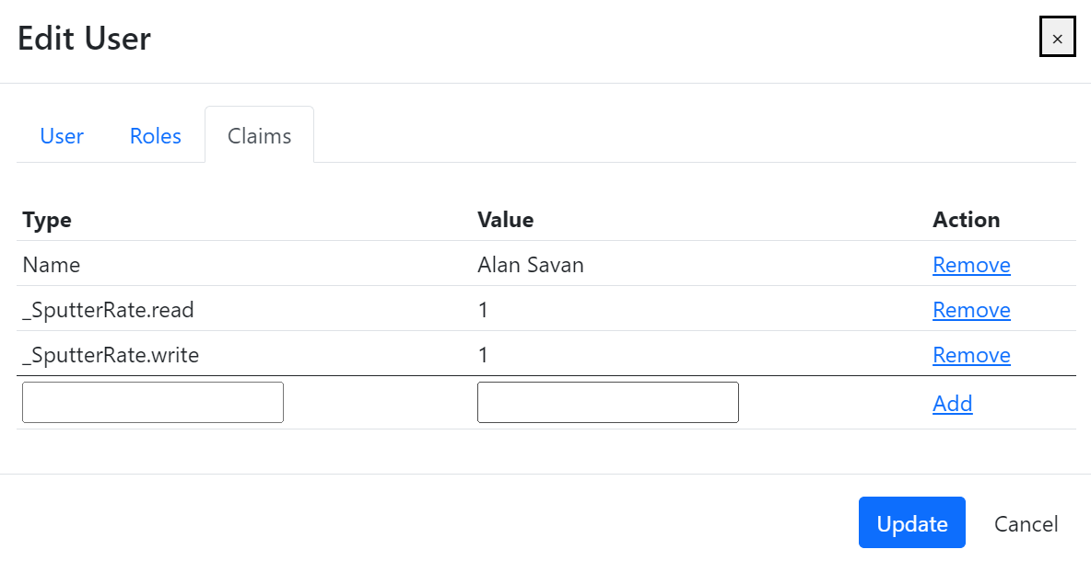
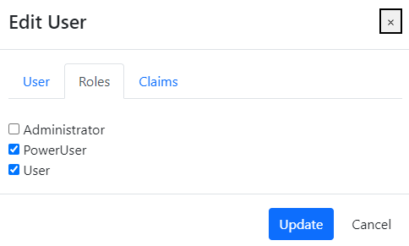
RDMS: Identity User Control Interface
Features:
Registered users management
Roles management
Claims management
Claim is a piece of information (key-value pair) that describes a user. Claims are stored in a user's identity and can be used to determine what actions a user is authorized to perform, such as accessing certain pages or resources.
https://learn.microsoft.com/en-us/aspnet/core/security/authentication/identity

Slide 5
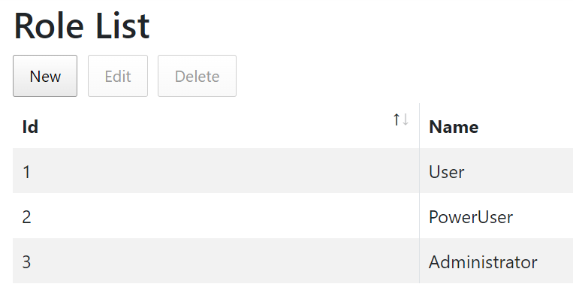
RDMS: Predefined Roles
Roles:
User:
    - read-only access to public and protected data
PowerUser:
- read-only access to public and protected data (+ private data, created by the current user)
- add data (+ write access to data, created by the current user)
Administrator:
- full access to all data (CRUD)
- user management
Anonymous (== registered user with no roles assigned):
- read-only access to public data only (be aware: internet search engines will index public data)
CRUD – Create, Read, Update, Delete

Slide 6
RDMS: Setting the Object Access Level
What is an Object?
Object (=document) is a data entry within RDMS that has user-defined access level and reflects an object of the real world (e.g. sample) or its model. Ultimately, object has it’s unique Web page (with unique URL address).
To establish data access policy Data Access Levels are introduced in RDMS.
Four Access Levels:
Public (default, we are doing open science, FAIR, aren’t we?):
    objects are available to everybody regardless of authorization (visible to internet search engines);
Protected (visible to the community only):
- objects are visible to the community (available to authorized users with at least User role assigned);
ProtectedNDA (restricted visiblility):
- objects are visible to the authorized users with NDA claim set OR to Administrators;
Private (person’s secret, but open for Administrators):
- objects are visible to the user-creator (at least PowerUser role assigned);
- objects are visible to all users of Administrator role.

Slide 7
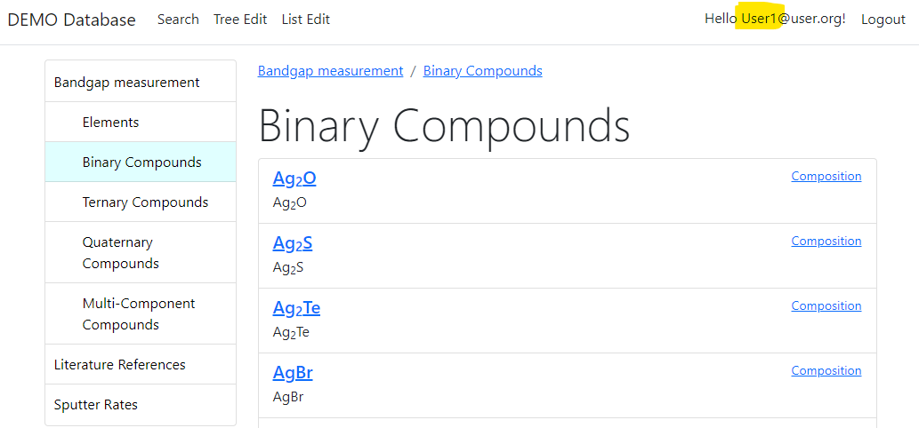
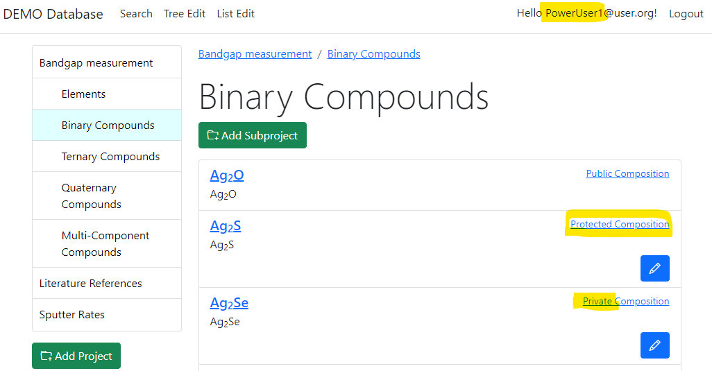
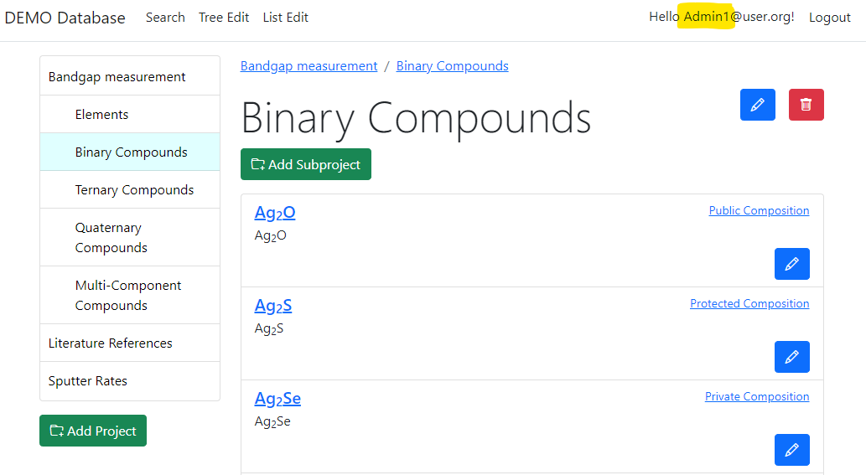
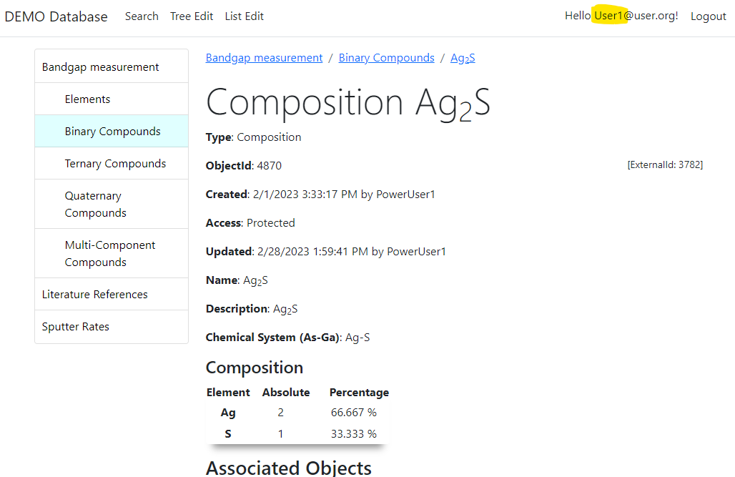
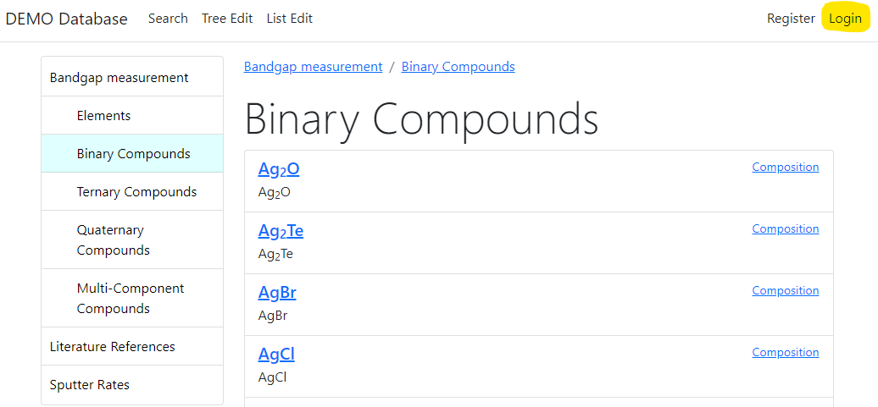

RDMS: Adjust Functionality According to User Permissions
User credentials (role) affects user interface: https://demo.mdi.ruhr-uni-bochum.de/rubric/binary-compounds
User1 (User role) PowerUser1 (PowerUser role) Admin1 (Administrator role)
Authorized CRC Community
User (no role) = Anonymous (search engine)
Preconditions:
Ag₂O created (public) by Admin1
Ag₂S created (protected) by PowerUser1
Ag₂Se created (private) by PowerUser1
Accessible (visible)
Denied (hidden)
Visit
https://demo.mdi.ruhr-uni-bochum.de/object/ag2s-4870
User => access granted
Anonymous => access denied
Login and Password (User): User1@user.org
Login and Password (PowerUser): PowerUser1@user.org
Login and Password (Administrator): Admin1@user.org
https://demo.mdi.ruhr-uni-bochum.de/rubric/binary-compounds

Slide 8

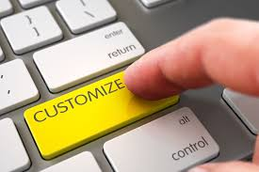
What about customization?
Basic (no-code)
  Introducing User-Defined Data Types:
    List templates
    Table templates
Simple (client-side code only)
  Page-code injection:
    HTML
    Javascript
    CSS
Complex (client- & server-side code)
  INF-code adjust (ASP.Net Core App)
    C#
    SQL
    HTML/Javascript/CSS

Slide 9
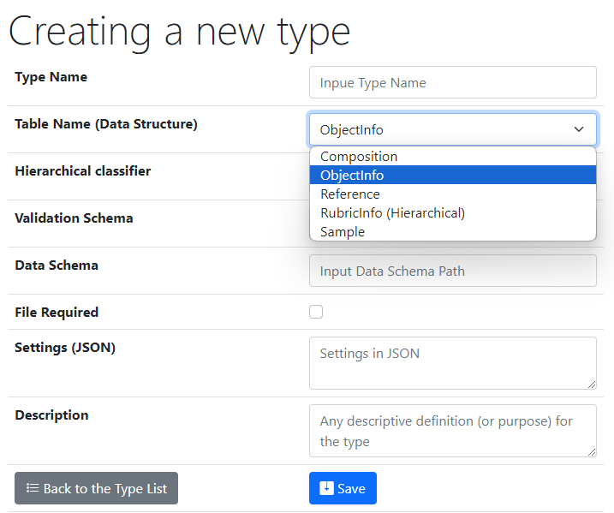
UI to create a new user-defined type
Type Name – user-defined type name
Core Object Types:
ObjectInfo – the simplest (bare) object
Sample – chemical system (set of chemical elements), for example Co-O
Composition – chemical composition (set of elements and quantities), for example Co₃O₄
Reference – literature reference (Authors, Title, Year, DOI, etc.)
Validation & Data Schema – only if you have external Web Services ready to validate & extract data from files
File Required – sets the file mandatory
Settings (JSON) – customization of type for RDMS
{ "CustomEditPath": "/custom/editsample",
"UrlPostVisualizer": "https://abc.de/VisualizeRT" }
Description – comments for type designation
We can further enrich defined object specification by customized (templates!) properties of primitive types: Integer, Float, String.

Slide 10
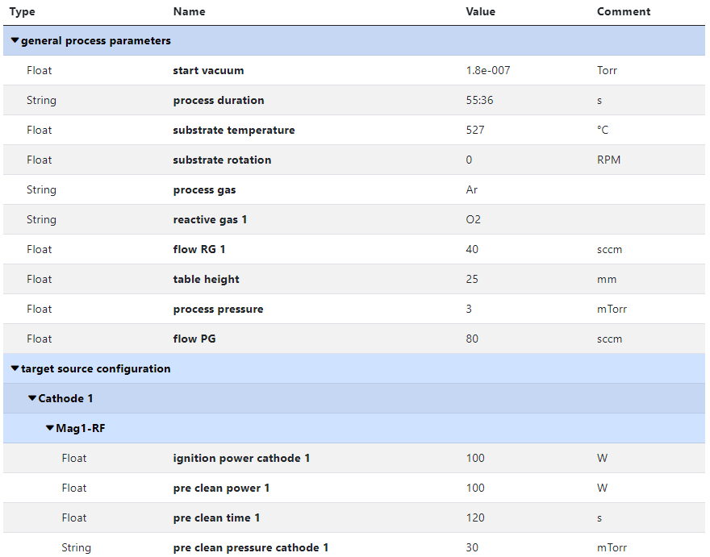
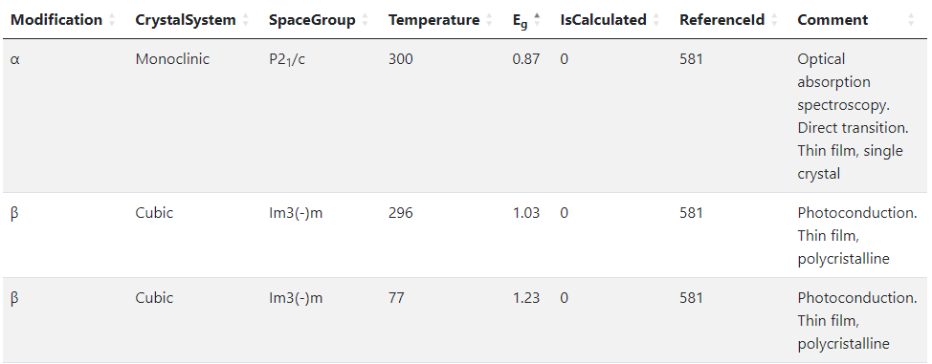
RDMS Templates for type
Template
List
(specify sorted properties list with separators)
Create an object with “_Template” name
Specify properties set
Table
(specify table structure: columns & types)
Data in a table with predefined structure
Key-value pairs
https://crc247.mdi.ruhr-uni-bochum.de/object/synthesis-for-sample-8220-co-deposition-221111-k3-3-1922
https://demo.mdi.ruhr-uni-bochum.de/object/ag2s-4870

Slide 11
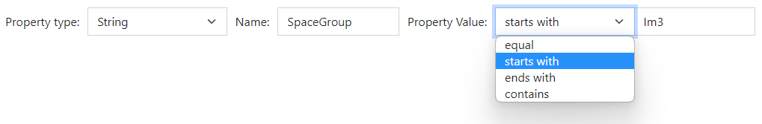
RDMS: Extended Properties & Search
All values are to be stored using appropriate data types!
DEFINITION: Data type is a collection or grouping of data values, usually specified by a set of possible values, a set of allowed operations on these values, and/or a representation of these values as machine types.
Supported data types (and their visualization in the search form):
Int – integer values (64-bit signed integer) in range [-9 223 372 036 854 775 808; 9 223 372 036 854 775 807].
Float – double-precision floating-point (8 bytes, IEEE-754), ±5.0×10⁻³²⁴ to ±1.7 × 10³⁰⁸.
String – any characters sequence no longer than 4096 symbols.
BigString – any characters sequence no longer than 2 147 483 647 symbols (2 Gb).
https://en.wikipedia.org/wiki/Data_type

Slide 12
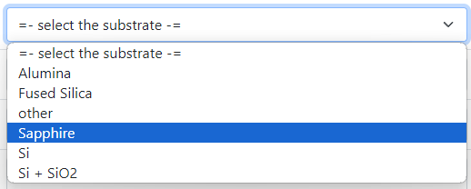

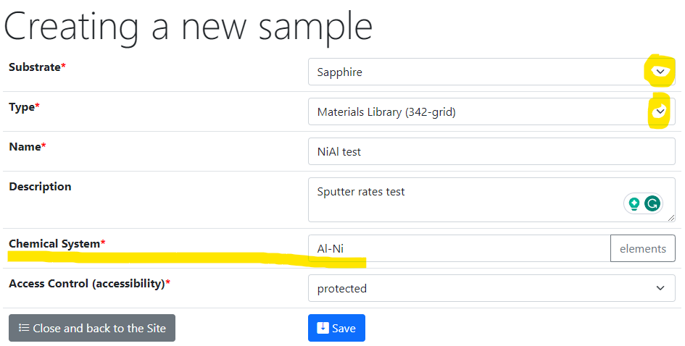
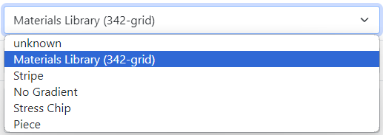
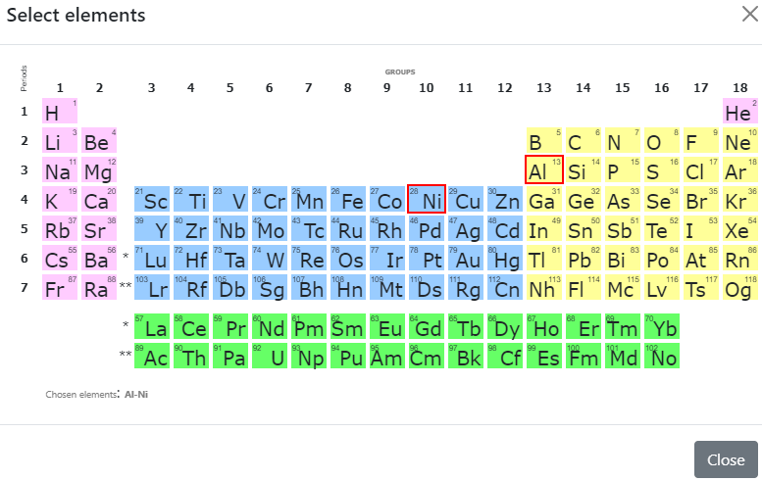
Sample Customised Form
List from subproject
- Customised sample input
List from JS-template
Standard chemical system
Customisation with UI form / JS
https://crc247.mdi.ruhr-uni-bochum.de/custom/editsample/0/?idr=179&returl=%2Frubric%2Farea-c_c04

Slide 13
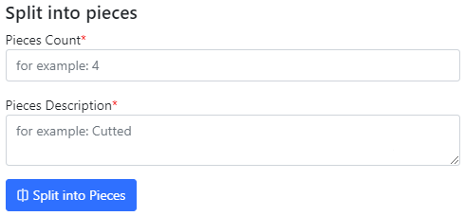
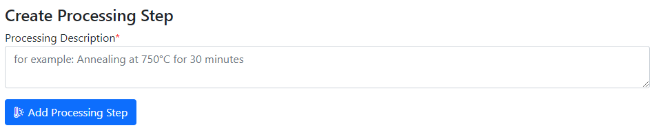
Use Case: Sample Transformation Workflow
Create Processing State & Split Sample
Sample_2a_2
(subsample 2a state 2)
polishing
Documents2a_2
Sample_2a
(subsample 2a)
annealing
splitting
Sample_2b_2
(subsample 2b state 2)
Sample
(initial state)
Sample_2
(changed state 2)
oxidation
Sample_2b
(subsample 2b)
documents
documents2
Documents2b_2
https://mdi.matinf.pro/custom/editsample/43508/?idr=2748&returl=%252Frubric%252Ftest

Slide 14
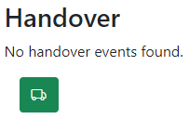
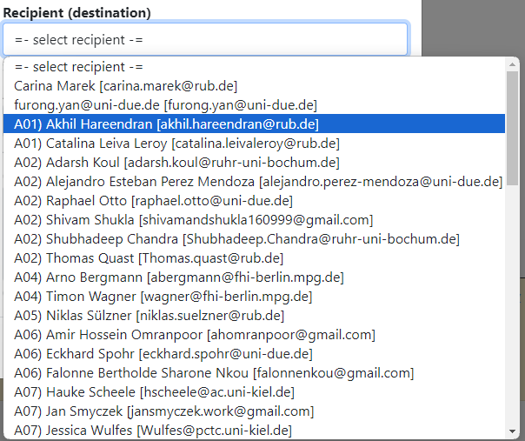
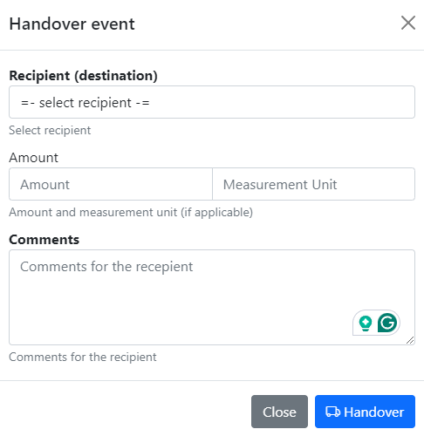
Tracking Samples or Handover event: initialisation
In “physically transferrable” objects (samples), find a green handover button
Select the recipient and press a blue button.
Select recipient
Specify Amount (optional)
Specify Comments
click

Slide 15
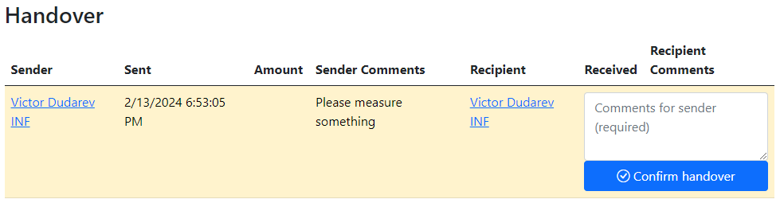
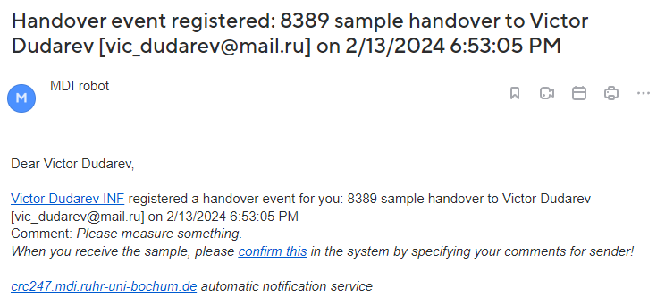
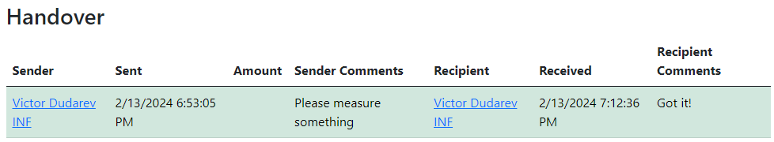
Tracking Samples or Handover event: delivering / delivered
Handover event is created
Recipient is notified by e-mail
3) Recipient should add comments and confirm the handover.
4) Confirmed
+ e-mail notification for sender

Slide 16
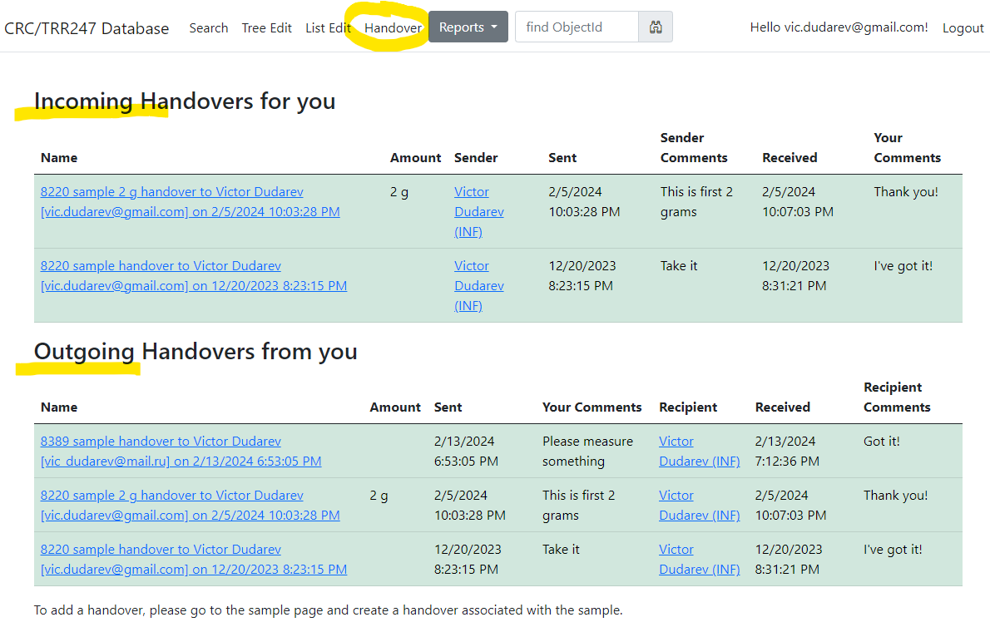
Tracking Samples or Handover event: user overview
Incoming
Outgoing
https://crc247.mdi.ruhr-uni-bochum.de/handover

Slide 17
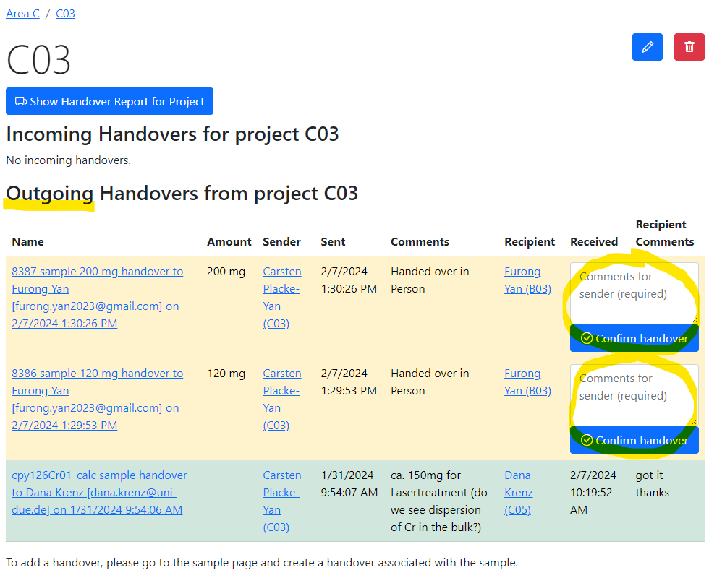
Tracking Samples or Handover event: project overview
Pending handovers (unconfirmed)
Successful handover
https://crc247.mdi.ruhr-uni-bochum.de/rubric/area-c_c03

Slide 18

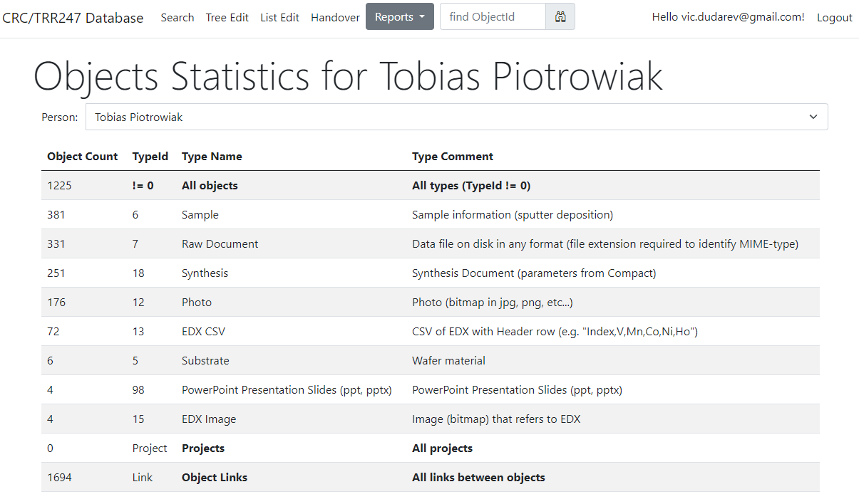
Reports & Statistics: Objects
Objects Statistics:
Objects (w.r.t. types)
Projects
Object Links
Feature:
Filter by person
https://crc247.mdi.ruhr-uni-bochum.de/report/objectsstatistics

Slide 19
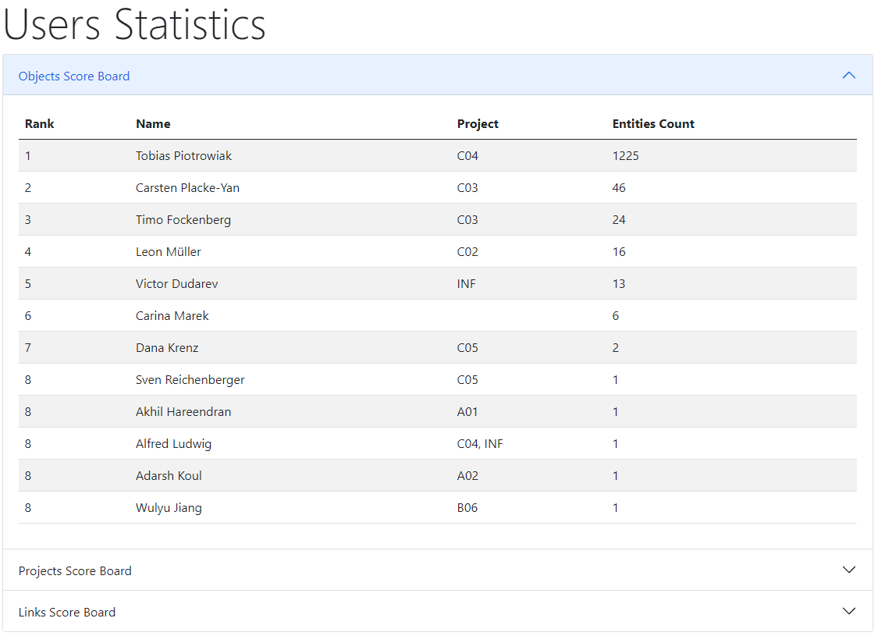

Reports & Statistics: Users
Users Statistics:
Objects
Projects
Links
https://crc247.mdi.ruhr-uni-bochum.de/report/usersstatistics

Slide 20



Project-wide Statistics / Person-wide Statistics
Even more is to be implemented…
Questions:
How productive is project/person in terms of adding data (objects creation)?
Is project subtree clearly structured (for manual subprojects traversing)?
What is the most referenced / liked object?
Awards from INF (the winner is…):
The most productive data creator award project/person
The people’s choice award: project subtree clarity
The citation / popularity award
?

Slide 21
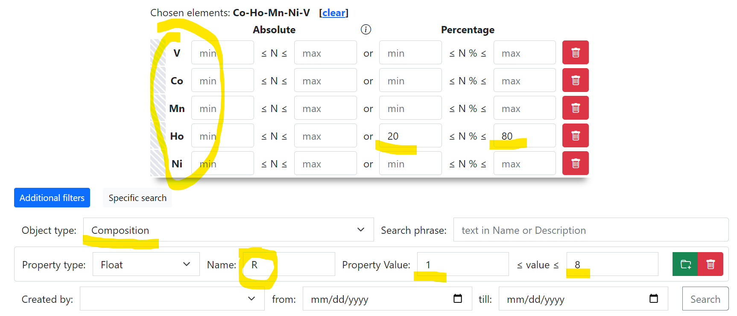
Use Case: Sample -> EDX -> Resistance
Create Project
Add Sample to Project
Add EDX document (342 Measurement Areas (MA), i.e. 342 Compositions)
Add Resistance document (associate property values to every MA)
Search for Composition with a given Resistance
Composition – object representing one of 342 measurement area
Container for other properties, associated with a certain measurement area
https://demi.matinf.pro/search/?system=Ni-V&typeid=8&Nipctmin=15&Nipctmax=20&pr0name=R&pr0type=Float&pr0min=10000000&pr0max=11111111&prcnt=1

Slide 22
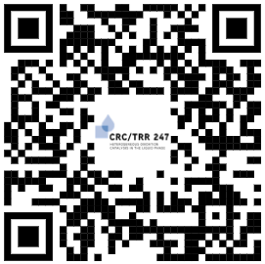
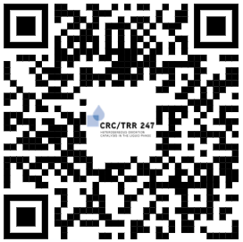
RDMS Playground
https://demo.mdi.ruhr-uni-bochum.de/ https://inf.mdi.ruhr-uni-bochum.de/
Playground to test RDMS (multiple tenants with shared users list):
https://demo.mdi.ruhr-uni-bochum.de/
https://inf.mdi.ruhr-uni-bochum.de/
Login and Password (User role): User1@user.org
Login and Password (PowerUser role): PowerUser1@user.org
Login and Password (Administrator role): Admin1@user.org
https://demo.mdi.ruhr-uni-bochum.de/
https://inf.mdi.ruhr-uni-bochum.de/
Notes:
https://qr.io/

Slide 23
RDMS in Production: demi.matinf.pro
Production mode (https://demi.matinf.pro/):
You need to register with Google account or create your own account (email/password) and confirm e-mail (warning: user created with no role assigned).
Write me in Slack (Direct Messages or #data_management), specifying your e-mail, used in registration, your name, organization/university (e.g. Ruhr University Bochum) and optional comments.
Wait… After manual processing you will be assigned by default a PowerUser role and you are in power of adding data ))
In case of any questions write me in Slack or by e-mail Victor.Dudarev@rub.de
Notes:
https://qr.io/

Slide 24
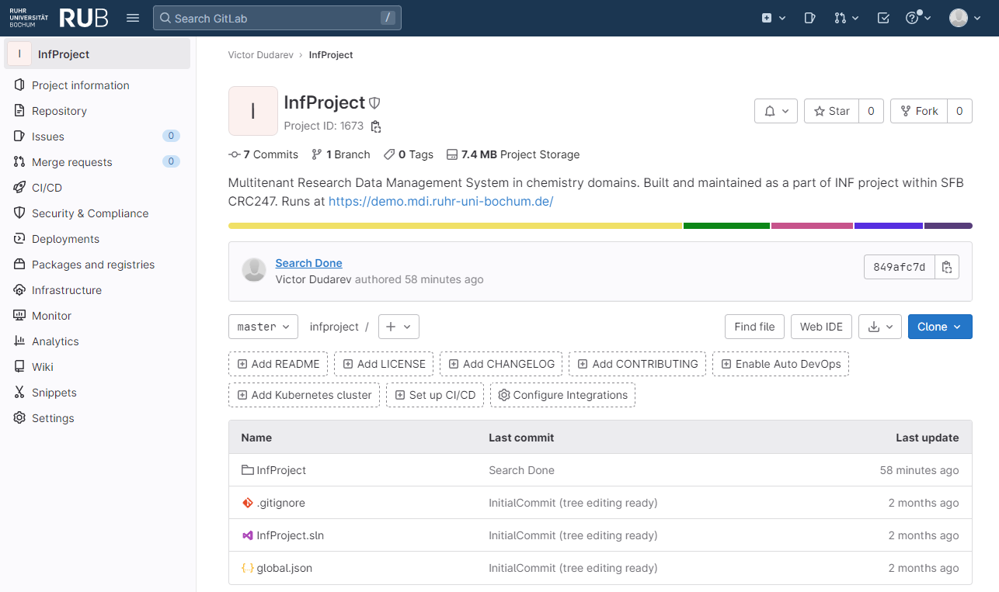

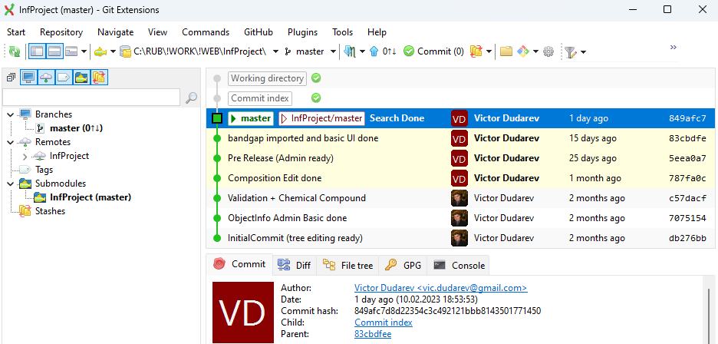



Source Control (GitLab)
Everybody’s welcome!
Feel free to contribute to open source!
Core INF project:
https://gitlab.ruhr-uni-bochum.de/vic/infproject
Shared projects (WebCompact):
1) Administration User Interface (Identity Manager UI):
https://gitlab.ruhr-uni-bochum.de/vic/identitymanagerui
2) Web Application General Library (WebUtilsLib):
https://gitlab.ruhr-uni-bochum.de/vic/webutilslib
https://gitlab.ruhr-uni-bochum.de

Slide 25
Thanks for your kind attention
Questions & Answers
Please write your questions in document (I will reply there, so we can make FAQ):
https://docs.google.com/document/d/1XqDlaSxRxqnigCT2mpn5jptllRlWgObB/edit?usp=sharing&ouid=117346421118620353373&rtpof=true&sd=true
Victor Dudarev
Victor.Dudarev@rub.de
https://vdudarev.ru

