Slide 1

Flexible Research Data Management System for Inorganic Materials Science
Victor Dudarev, Alfred Ludwig

Slide 2

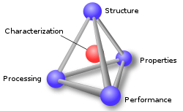

RDMS Core Features
Support for multiple Tenants;
Flexible Project Tree;
User-defined Object Type support:
  Properties Templates
  Table Templates
  Document Validation
  Data Extraction
  Data Visualization
Batch Import of Documents
UI Customization (with HTML/JS/CSS injection)
System
(qualitative composition)
In-S
Substance
(quantitative composition)
In₂S₃
Modification
(crystal structure type)
β-In₂S₃
…
Priorities: Security, Scalability, Flexibility
RDMS: Research Data Management System

Slide 3
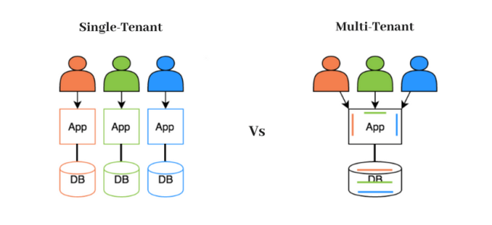
RDMS: Multiple Tenant Support
What is Tenant?
Short answer:
Tenant – separate (distinct) instance of a software application that
is used by a single organization or group of users.
Long answer:
Tenant is a customer account that has its own set of users, data, and configuration settings, and is isolated from other tenants in the same software application. This concept is commonly used in Software as a Service (SaaS) applications, where a single software application is hosted in the cloud and is made available to multiple customers as separate tenants. This allows each customer to have their own instance of the application, with their own data, settings, and customizations, while still sharing the underlying infrastructure and resources of the application
Conclusion:
Tenants are useful for separate projects / workgroups / materials data repositories. For example:
          https://demo.mdi.ruhr-uni-bochum.de/
          https://inf.mdi.ruhr-uni-bochum.de/
          https://dim.mdi.ruhr-uni-bochum.de/
          https://mdi.matinf. pro/
Every tenant must have a unique URL!
https://en.wikipedia.org/wiki/Multitenancy

Slide 4
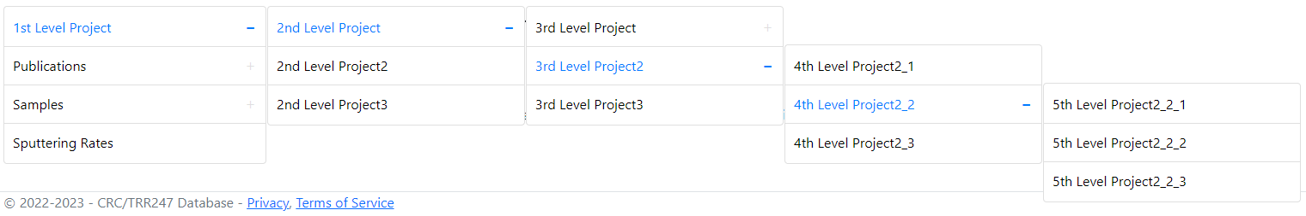
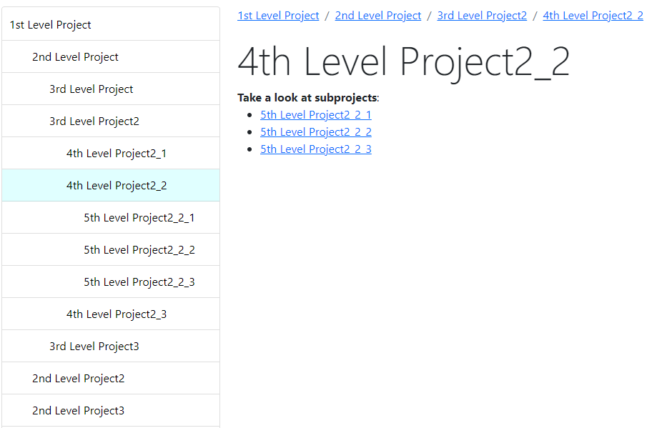
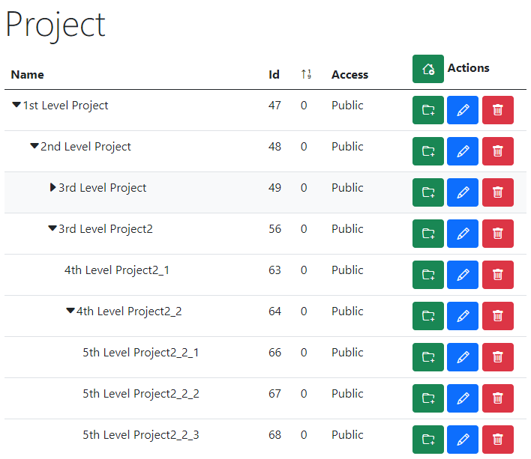
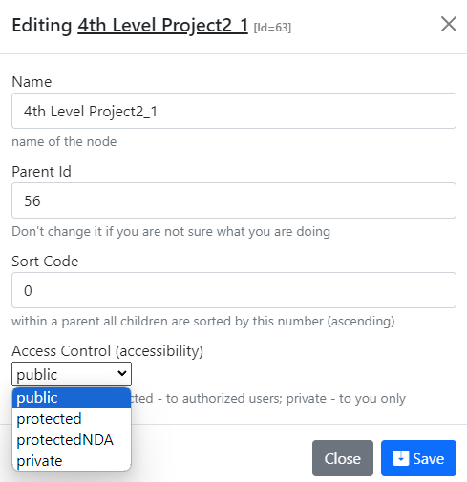
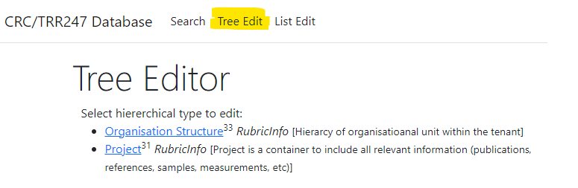
RDMS Tree Types: control and display
Display for users in Web Application
Control (admin):
Name
Parent Id
Sort Code
Access
https://demo.mdi.ruhr-uni-bochum.de/

Slide 5
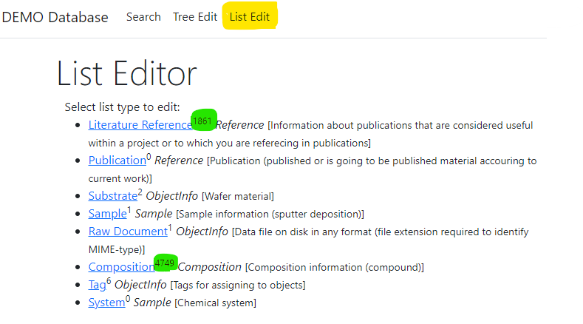
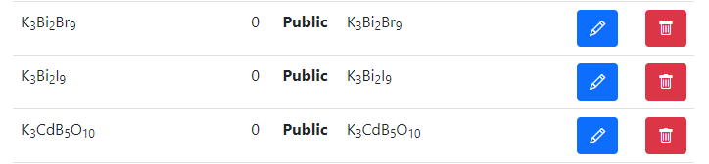
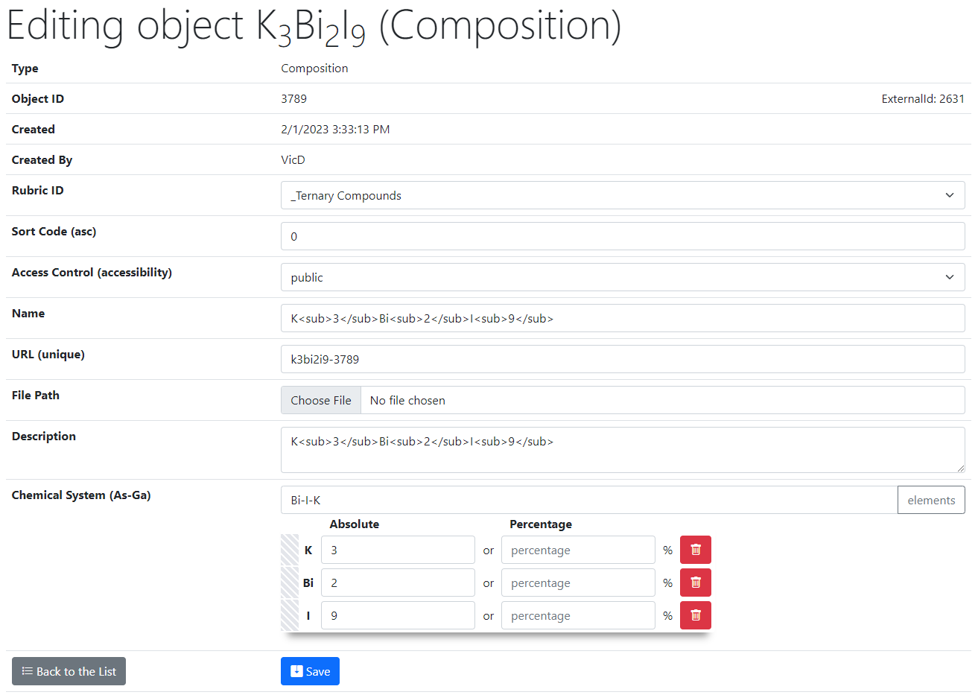
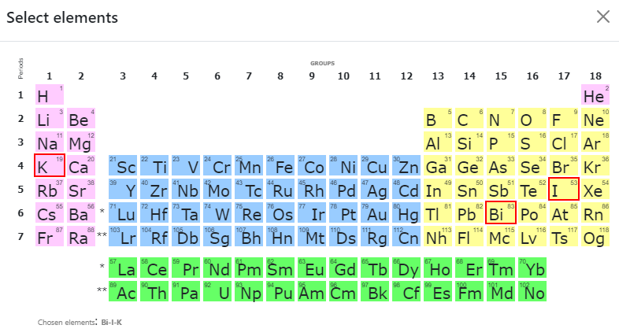
RDMS List Types: add composition
List of all objects (of type Composition):
Control (common to all objects):
Rubric Id;
Sort Code;
Access;
Name;
URL (adjustable*);
Attach File (document);
Description.
2
Type specific control (e.g. Composition):
Chemical System;
Composition (elements containment).
1
https://demo.mdi.ruhr-uni-bochum.de/object/k3bi2i9-3789
https://demo.mdi.ruhr-uni-bochum.de/adminobject/edititem/3789

Slide 6
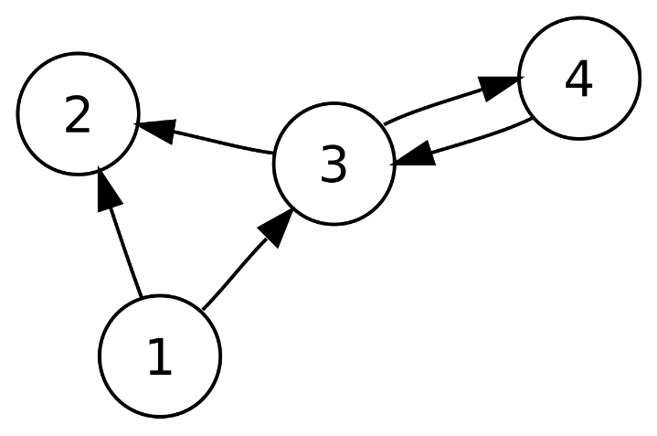
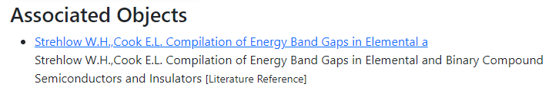
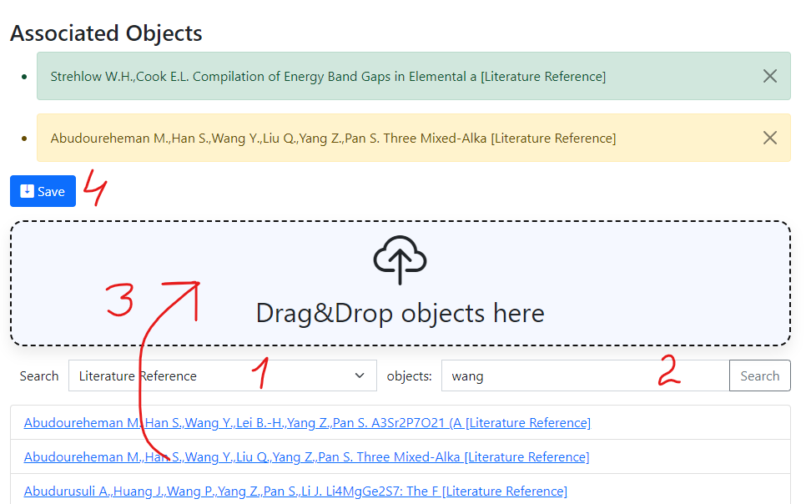
RDMS: Interlink Objects
Example: literature reference for published data on composition:
To add associated objects:
0) Go to “List edit” or select object to edit
1) Select associated object type (optional filter)
2) Input search phrase, contained in the Name of desired object to be associated
3) Drag & Drop desired object(s) from search result list to the area / adjust list
4) Save changes
Important: Reverse associations allow to browse reverse- directional associations, such as finding all compounds mentioned in a particular literature reference.
User view: https://demo.mdi.ruhr-uni-bochum.de/object/ag2s-4870
Admin view: https://demo.mdi.ruhr-uni-bochum.de/adminobject/edititem/4870

Slide 7
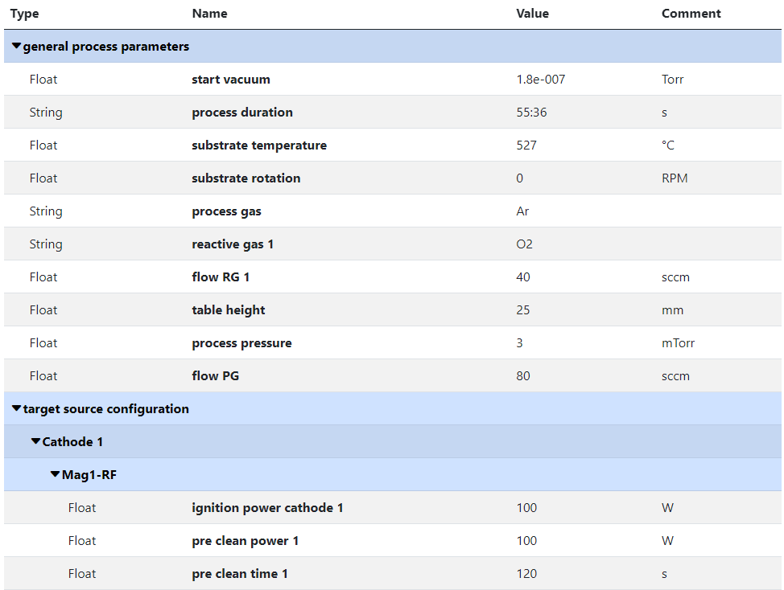
RDMS Object‘s Flexibility: Extended Properties with Separators
Measurement Units
Use case: add additional properties values to object and afterward make search on them.
Task: associate typed properties with object Synthesis parameters
Values Types
Separators
(logical blocks)
SortCode
https://crc247.mdi.ruhr-uni-bochum.de/object/synthesis-for-sample-8220-co-deposition-221111-k3-3-1922

Slide 8
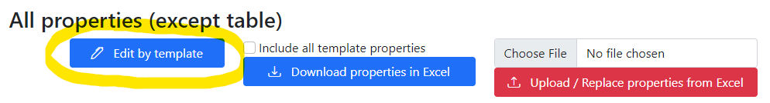
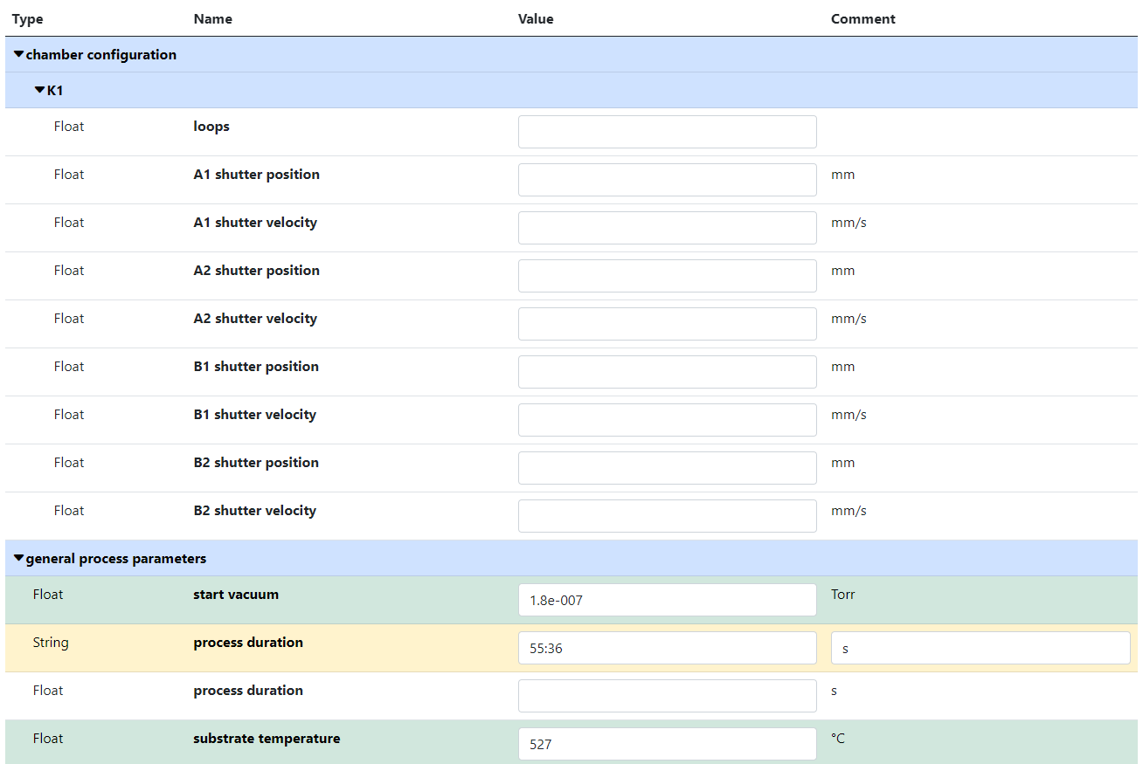
RDMS Extended Properties: Using Template to fill in data
Use case: take advantage of created template during data input.
Task: edit synthesis properties.
Empty values
(white)
Values Types
SortCode
Separators
(logical blocks)
Filled values
(green)
Out of template values
(yellow)
https://crc247.mdi.ruhr-uni-bochum.de/object/synthesis-for-sample-8220-co-deposition-221111-k3-3-1922
https://crc247.mdi.ruhr-uni-bochum.de/properties/edititem/1922

Slide 9
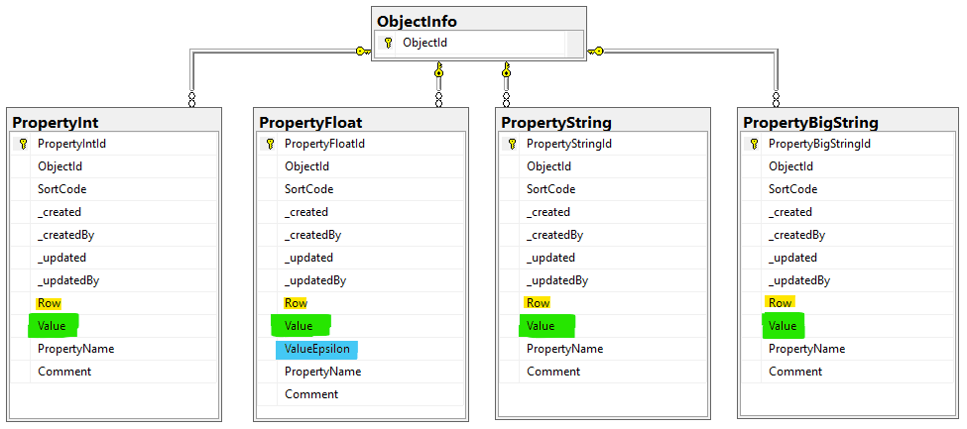
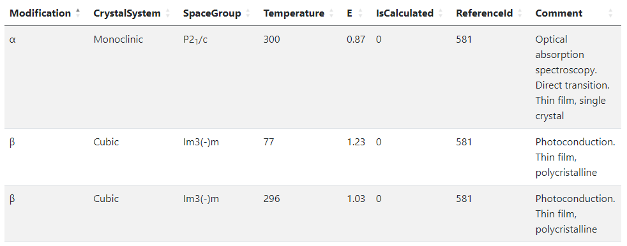
RDMS Object‘s Flexibility: Extended Properties (table data)
Use case: add additional properties values (or even a table) to object and afterward make search on them.
OR
When the existing fields set is not enough…
Task: associate table with object
Row=1
Row=2
Row=3
String x3
Float x2
Int x2
String
Solution: Decompose the table so, that each cell value is stored in Property* table according to cell value type.
Important attributes:
PropertyName – contains column name
Value – contains cell value
Row – contains row number (1, 2, 3, …). If no row number specified – value is threated as object’s property
User view: https://demo.mdi.ruhr-uni-bochum.de/object/ag2s-4870
Admin view: https://demo.mdi.ruhr-uni-bochum.de/adminobject/edititem/4870

Slide 10
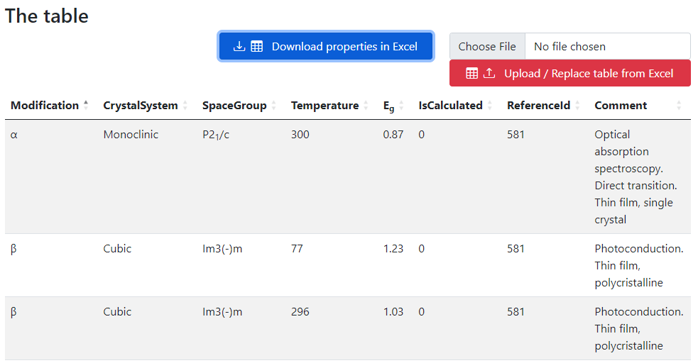
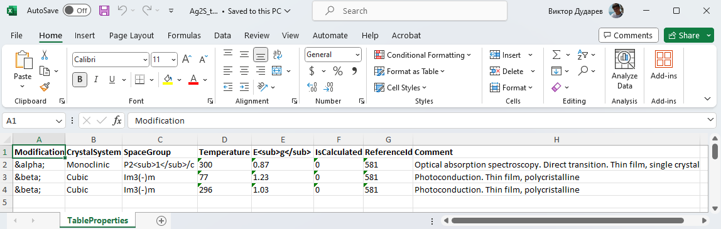
RDMS Table Data: Export and Import
Task: make table properties modification easy
Steps:
Download data
Open in Excel and edit
Upload changed data back to the RDMS
Import
(requires permissions)
https://demo.mdi.ruhr-uni-bochum.de/object/ag2s-4870
Export
https://demo.mdi.ruhr-uni-bochum.de/object/ag2s-4870

Slide 11
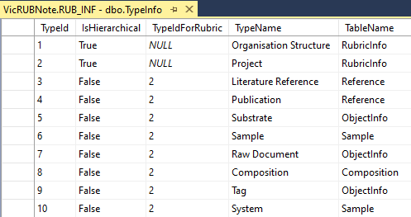
RDMS Extensibility: User-defined Object Types
New Object Type
Task: introduce new object types
Based on existing tables
(hierarchical and non-hierarchical)
New Data Structures
(new table & code to fit particular requirements)
Add new type to TypeInfo table
Added by admin (UI)
Approximate time: 3 minutes
Just add a new table row with object specification required (assign validator; data extractor; data visualizer, etc…)
To be done manually
Approximate time: 1 week
Tasks: develop and add new table; define read / write logic with respect to mandatory (or optional) fields and types; reflect to OOP model and provide consistency check (validators); develop import / export and search facilities, etc.
Question: It seems that all can be done with extended properties.
Why to use new data structures?
Short Answer: Performance (especially if number of new type objects is expected to exceed 10K)

Slide 12
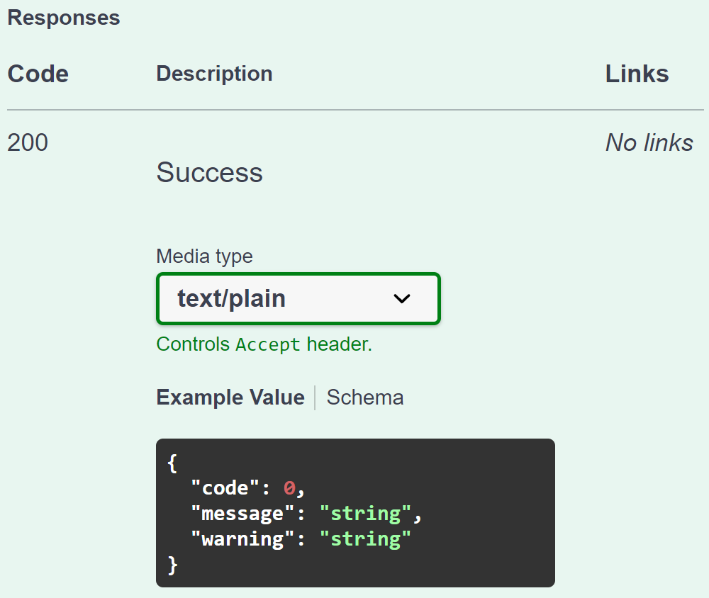
Validation from RDMS perspective: API makes it flexible for all
Provide a validator for every object type in configuration:
type: built-in type (object instantiated by class name);
https: URL to a REST Service (OpenAPI specification).
{
"Code": 0,
"Message": null,
"Warning": null
}
type:TypeValidationLibrary.TypeValidator_EDX_CSV (interface IFileValidator)
https://validation.matinf.pro/edx/validation
valid
Validation result
via external API call
External service decision
invalid
type
{
"Code": 500,
"Message": "error text",
"Warning": null
}
API – Application Programming Interface
URL – Uniform Resource Locator
REST – REpresentational State Transfer

Slide 13
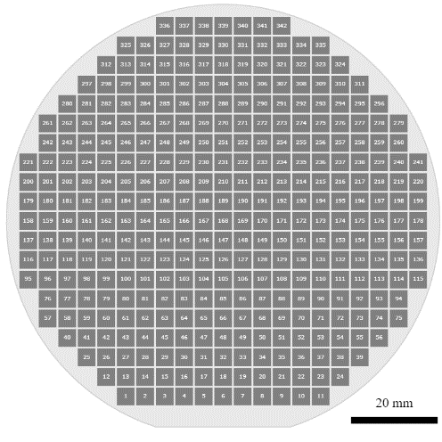
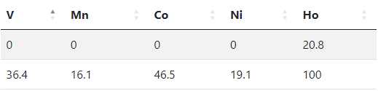
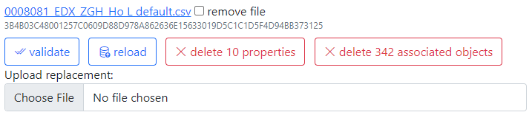
Metadata extraction: external API
Provide a data extractor for every object type in configuration:
type: built-in type (object instantiated by class name);
https: URL to a REST Service (OpenAPI specification).
type:TypeValidationLibrary.TypeValidator_EDX_CSV (interface IDatabaseValuesGetter)
https://validation.matinf.pro/edx/data
{ "DeletePreviousProperties": true,
"Properties": [
{ "PropertyId": 0,
"Type": 1,
"Name": "V",
"Value": 0,
"ValueEpsilon": null,
"SortCode": 10,
"Row": 1,
"Comment": "Minimal V content"
},
{ "PropertyId": 0,
"Type": 1,
"Name": "V",
"Value": 36.400001525878906,
"ValueEpsilon": null,
"SortCode": 10,
"Row": 2,
"Comment": "Maximal V content"
}
]
}
Metadata for EDX (range values):
Administrative interface: Compositions
EDX - Energy-dispersive X-ray spectroscopy

Slide 14
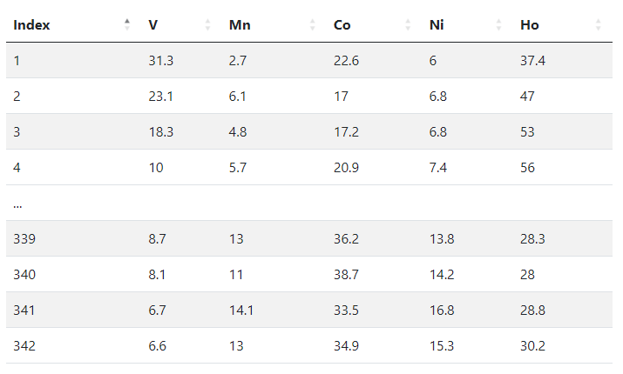
All data extraction: external API
Provide a data extractor for every object type in configuration:
type: built-in type (object instantiated by class name);
https: URL to a REST Service (OpenAPI specification).
type:TypeValidationLibrary.TypeValidator_EDX_CSV (interface IDatabaseValuesGetter)
https://validation.matinf.pro/edx/data
Data from EDX (all values == 342 compositions):
{
"CompositionElements": [
{ "CompoundIndex": 0, "ElementName": "V", "ValueAbsolute": null, "ValuePercent": 31.299999237060547 },
{ "CompoundIndex": 10, "ElementName": "Mn", "ValueAbsolute": null, "ValuePercent": 2.700000047683716 },
{ "CompoundIndex": 20, "ElementName": "Co", "ValueAbsolute": null, "ValuePercent": 22.600000381469727 },
{ "CompoundIndex": 30, "ElementName": "Ni", "ValueAbsolute": null, "ValuePercent": 6 },
{ "CompoundIndex": 40, "ElementName": "Ho", "ValueAbsolute": null, "ValuePercent": 37.400001525878906 }
],
"DeletePreviousProperties": true,
"Properties": [
{
"PropertyId": 0, "Type": 2, "Name": "Measurement Area", "Value": 1, "ValueEpsilon": null,
"SortCode": 0, "Row": null, "Comment": null
}
]
}

Slide 15
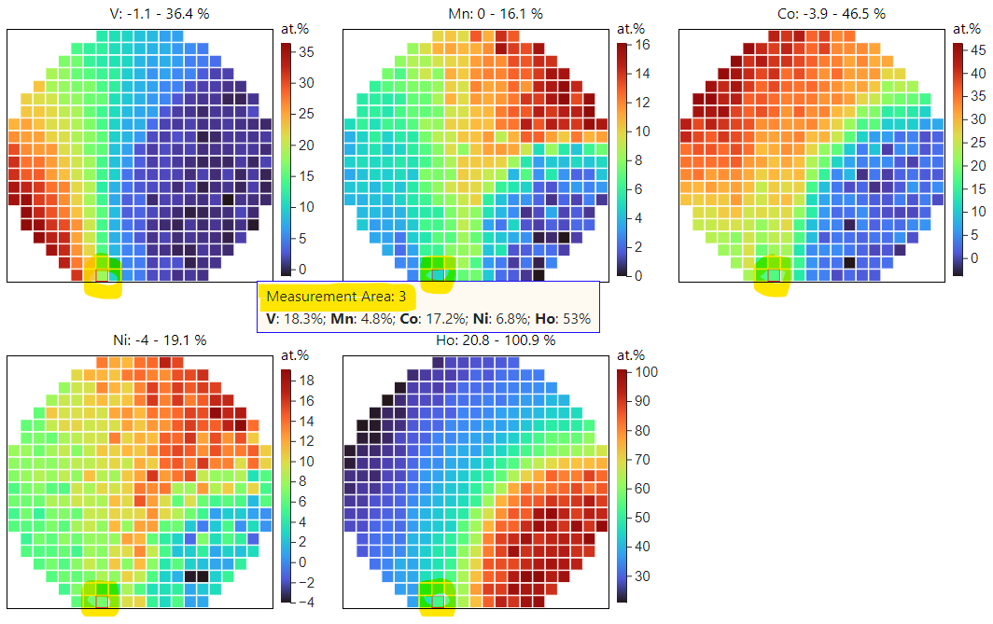
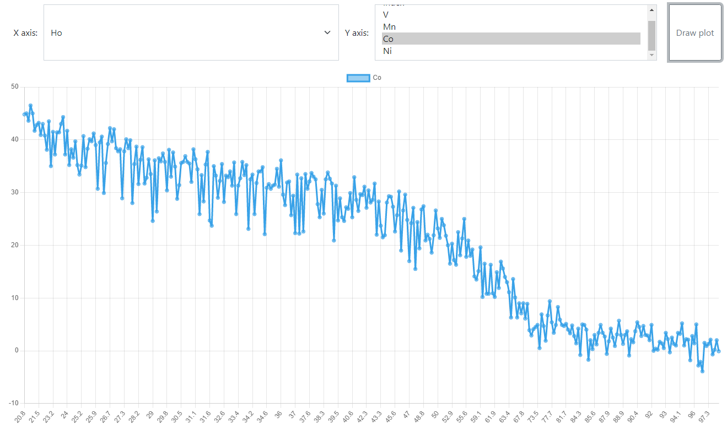
EDX Data Visualization
After processing one can conclude with the final outcome
V: 18.3 %
Mn: 4.8 %
Co: 17.2 %
Ni: 6.8 %
Ho: 53 %
Measurement Area Index Chemical Elements
[1, 342]
Composition for the Measurement Area 3 (atomic %)
Measurement
Area 3
Composition
Data
Configurable XY-charts
https://dim.mdi.ruhr-uni-bochum.de/file/csv/6691

Slide 16
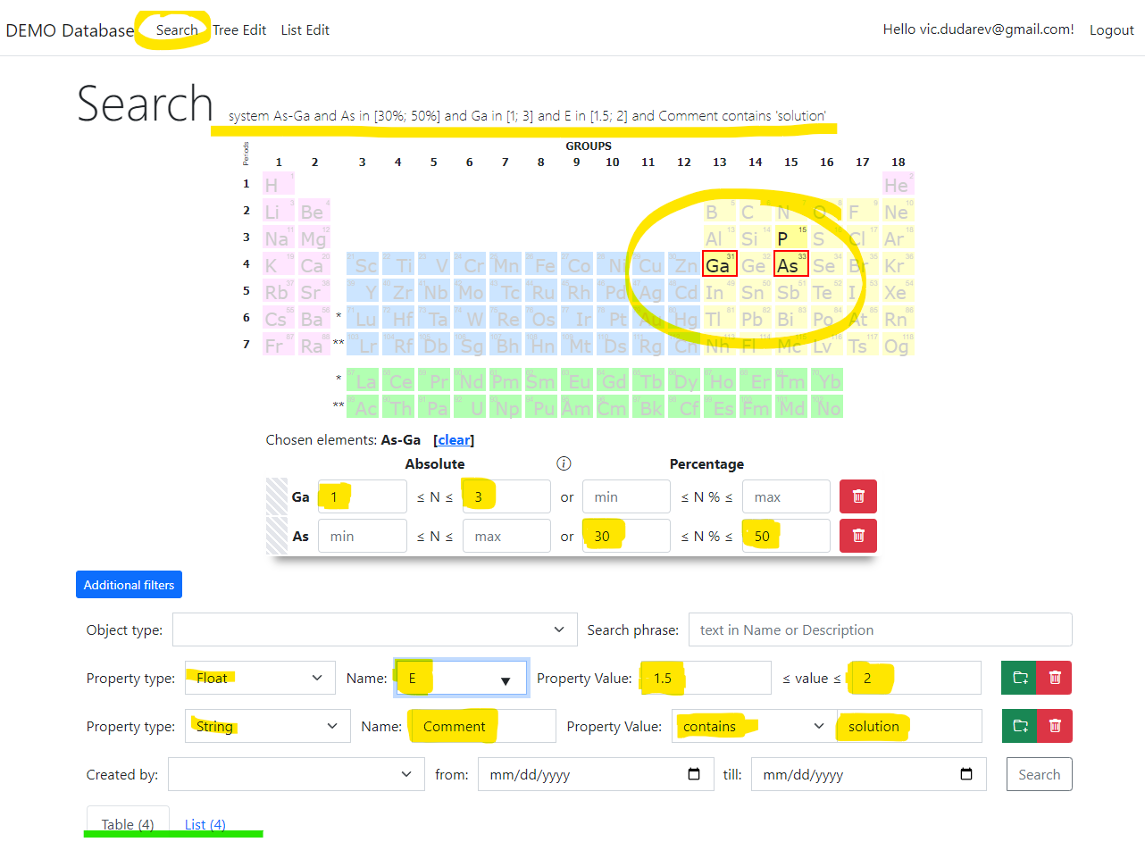
RDMS: Search
Search on:
Chemical system
Composition
Object type
Phrase in object’s Name or Description
Properties values (all available within a tenant)
Person created
Creation date
Important feature:
persistent URL on search (share search results easily by URL*).
* - respecting current security context
https://demo.mdi.ruhr-uni-bochum.de/search/
https://demo.mdi.ruhr-uni-bochum.de/search/?system=As-Ga&typeid=8&Aspctmin=30&Aspctmax=50&Gaabsmin=1&Gaabsmax=3&pr0name=E%3Csub%3Eg%3C%2Fsub%3E&pr0type=Float&pr0min=1.5&pr0max=2&pr1name=Comment&pr1type=String&pr1max=3&pr1str=solution&prcnt=2
https://demo.mdi.ruhr-uni-bochum.de/search/?system=As-Ga&typeid=8&Aspctmin=30&Aspctmax=50&Gaabsmin=1&Gaabsmax=3&pr0name=E%3Csub%3Eg%3C%2Fsub%3E&pr0type=Float&pr0min=1.5&pr0max=2&prcnt=1

Slide 17
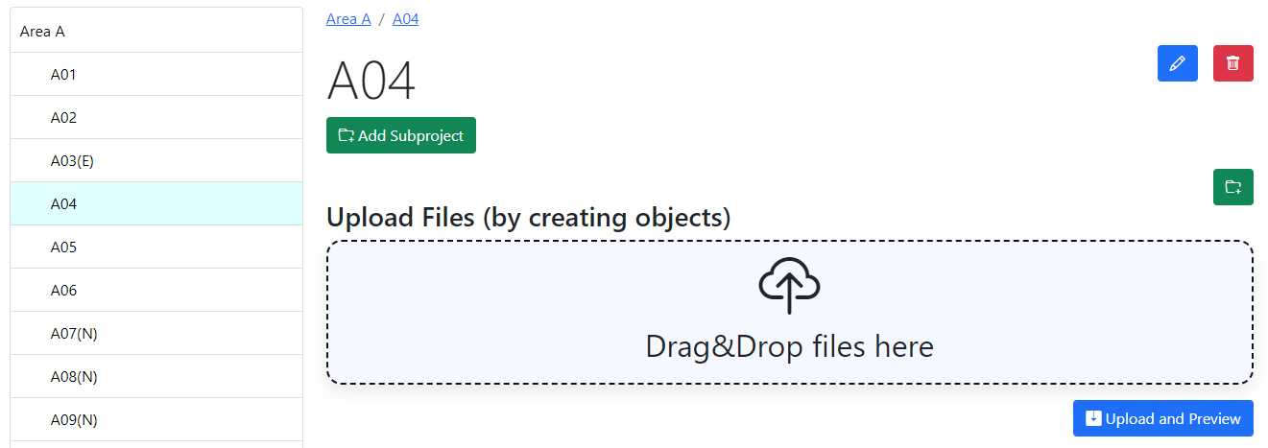
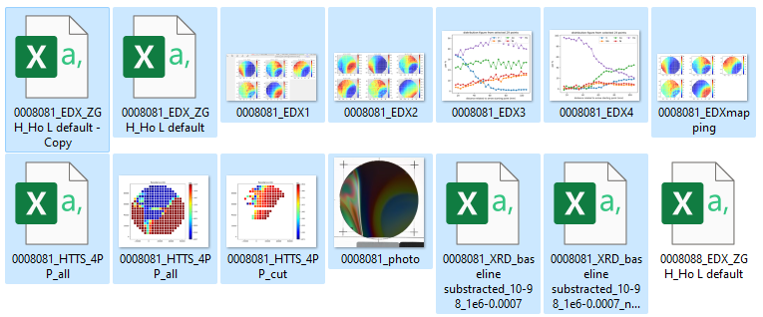
RDMS DropZone Tasks: Data Validation & Import
Task: validate documents & import data
Implemented Features:
Automatic type detection;
Uniqueness check;
Data validation (build-in + external);
Data import.

Slide 18

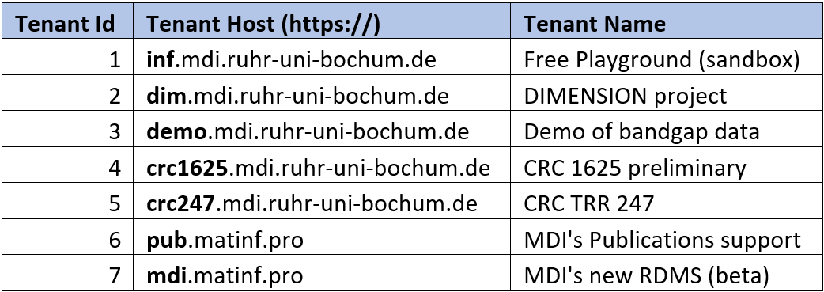





Conclusion
Open-source RDMS framework in materials science:
Flexible project tree
Build-in support for basic chemical types
Extensible external object types support (via API):
  Validation
  Data extraction
  Visualization
Extended properties and templates
Flexible Search
UI Customization for tenants
Active tenants:
Playground to test RDMS (multiple tenants with shared users list):
https://inf.mdi.ruhr-uni-bochum.de/
Login and Password (User role): User1@user.org
Login and Password (PowerUser role): PowerUser1@user.org
Login and Password (Administrator role): Admin1@user.org
Bandgap data demo:
https://demo.mdi.ruhr-uni-bochum.de/
https://demo.mdi.ruhr-uni-bochum.de/ Production: https://demo.matinf.pro/
https://inf.mdi.ruhr-uni-bochum.de/
https://gitlab.ruhr-uni-bochum.de/vic/infproject
Notes:
https://qr.io/

Slide 19
Thanks for your kind attention
Demonstration
Q&A
Victor Dudarev
Victor.Dudarev@rub.de
https://vdudarev.ru

